Slide 1

SIDDHARTH INSTITUTE OF ENGINEERING & TECHNOLOGY
(AUTONOMOUS)
(Approved by AICTE, New Delhi & Affiliated to JNTUA, Ananthapuramu)
(Accredited by NBA for Civil, EEE, Mech., ECE & CSE
Accredited by NAAC with ‘A+’ Grade)
Puttur -517583,Tirupathi District, A.P. (India)
DEPARTMENT OF COMPUTER SCIENCE AND ENGINEERING
CSE (ARTIFICIAL INTELLIGENCE AND DATA SCIENCE
Academic Year 2025-26
Project Second Review
Title of Project : Intelligent Infant Health Predictor with Personalized AI Guidance
Batch Details
S.NO: | REG NO | NAME | INTERNAL GUIDE
1 | 22F61A4788 | K LALITH | B. SRINIVASULU M.TECH ASST. PROFESSOR
2 | 22F61A4793 | P MAHITHA PRANATHI
3 | 22F61A4790 | P MADHU
4 | 22F61A47A0 | K MANOJKUMAR

Slide 2
OBJECTIVE
Build a supervised Machine Learning model (CatBoost) to accurately predict infant mortality risk and classify infants into Low-Risk and High-Risk categories.
Integrate a GPT-based AI Engine (HuggingFace) to generate personalized and actionable survival plans for infants identified as high-risk.
Develop a user-friendly web interface that allows healthcare workers and caregivers to enter infant health data and instantly receive predictions and AI-generated guidance.
Enhance proactive pediatric care by combining ML-based risk assessment with tailored intervention recommendations.
Evaluate system performance using model accuracy, confusion matrix, and real/simulated datasets to ensure reliability and clinical relevance.

Slide 3
ABSTRACT
Infant mortality remains a critical global health challenge, especially among children under the age of five. Early identification of infants who are at higher risk is essential for enabling timely intervention and improving survival outcomes.
This project introduces an integrated Machine Learning + AI–driven framework designed to assess infant mortality risk using key maternal and infant health indicators, including:
  Birth weight
  Maternal age
  Immunization status
  Nutrition score
  Socioeconomic category
  Prenatal care visits
Using these features, the system applies supervised machine learning classification techniques to predict mortality risk. Multiple models were trained and evaluated using a balanced dataset (SMOTE), and CatBoostClassifier achieved the highest accuracy and was selected as the final predictive model.

Slide 4
ABSTRACT
Infants identified as high-risk receive a personalized survival plan generated through an integrated GPT-based AI module. These plans provide actionable, year-wise recommendations, including:
  Nutrition improvements
  Preventive healthcare steps
  Follow-up and monitoring schedules
  Early childhood developmental activities
The system is deployed through a web-based interface, enabling caregivers and healthcare workers to enter infant health details and instantly receive the ML-predicted risk along with AI-generated guidance.
With a trained CatBoostClassifier model powering risk prediction and a robust GPT engine generating structured survival plans, the system demonstrates strong potential to enhance pediatric care through data-driven decision support and intelligent recommendation generation.

Slide 5
Literature Review
Title of the paper | Authors | Year | Implications
Intelligent Health Monitoring System for Infants Using ML | M. Singh, K. Rao | 2023 | Shows that ML-based monitoring enables early detection of infant health risks and timely intervention.
Artificial Intelligence-Based Clinical Decision Support Systems | A. Johnson, M. Smith, R. Brown | 2022 | Demonstrates that AI-based systems enhance clinical decision-making when combined with actionable insights.
Deep Learning Models for Neonatal Mortality Risk Assessment | Y. Zhang, L. Wang, H. Chen | 2021 | Shows improved prediction accuracy with large datasets but highlights the lack of explainability in deep learning models.
Machine Learning Approaches for Infant Mortality Prediction | K. Singh, R. Patel, S. Verma | 2020 | Proves that machine learning can effectively predict infant mortality risk using maternal and neonatal health data.

Slide 6
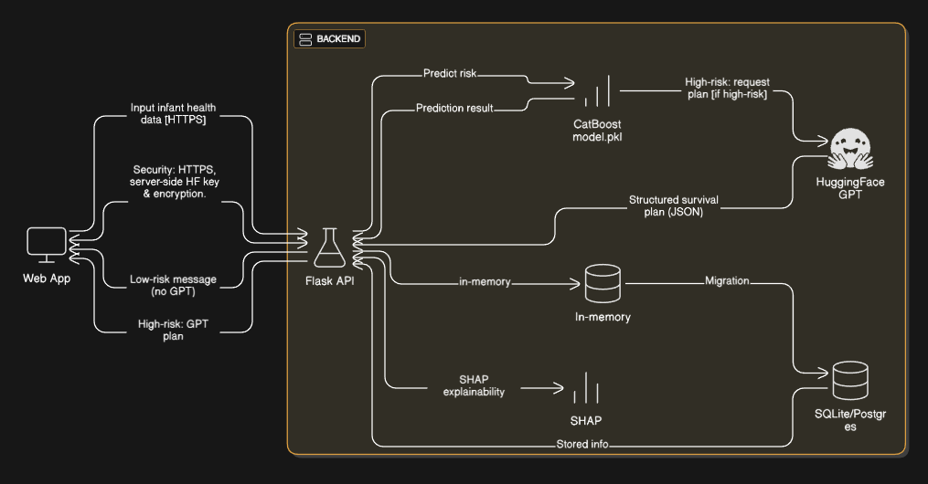
Architecture Diagram

Slide 7
Modules
User Authentication Module
User Interface & Input Collection Module
Machine Learning Prediction Module
AI Survival Plan Generator Module
Explainable AI (XAI) Module
Data Handling & Persistent Storage Module

Slide 8
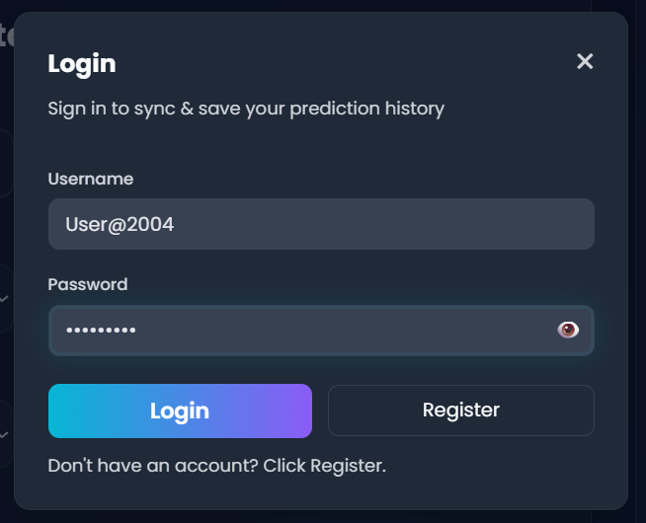
Modules
User Authentication Module
  Provides secure access and personalized history management for each user.
  Key Functionalities:
  User Registration – Creates new accounts with securely hashed passwords
  User Login – Session-based authentication using Flask server sessions
  Guest-to-User Sync – Merges guest predictions into user’s permanent history after login
  Secure Session Handling – Protects user data and prevents unauthorized access

Slide 9
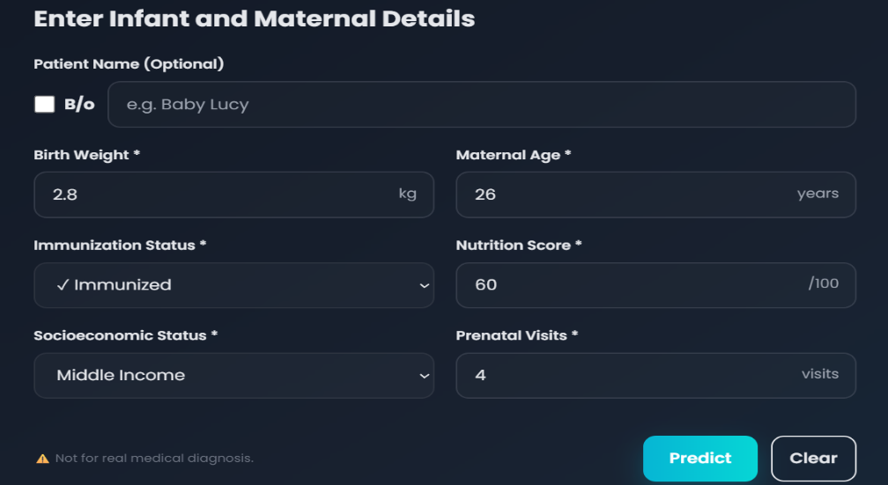
Modules
User Interface & Input Collection Module
  Delivers an interactive interface for entering infant details and viewing prediction results.
  Key Functionalities:
  Input Collection –Gathers birth weight, maternal age, immunization, nutrition, socioeconomic status, and prenatal visits
  Responsive & Modern UI – Built with HTML/CSS/JS; supports dark mode and smooth transitions
  Real-Time Results Display – Shows probability meter, risk category, and survival plan

Slide 10
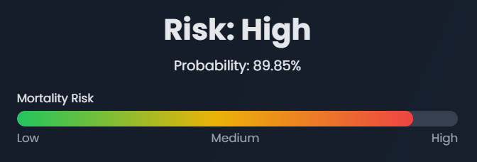
Modules
Machine Learning Prediction Module
  Generates accurate risk predictions based on infant health parameters.
  Key Functionalities:
  Input Validation – Converts numeric and categorical data into ML-ready format.
  Model Inference – Uses the trained model (model.pkl) and produces risk probability and classification
  Optimized Pipeline – Fast prediction with pre-loaded model.pkl
  Results – Probability, Risk category for frontend display

Slide 11
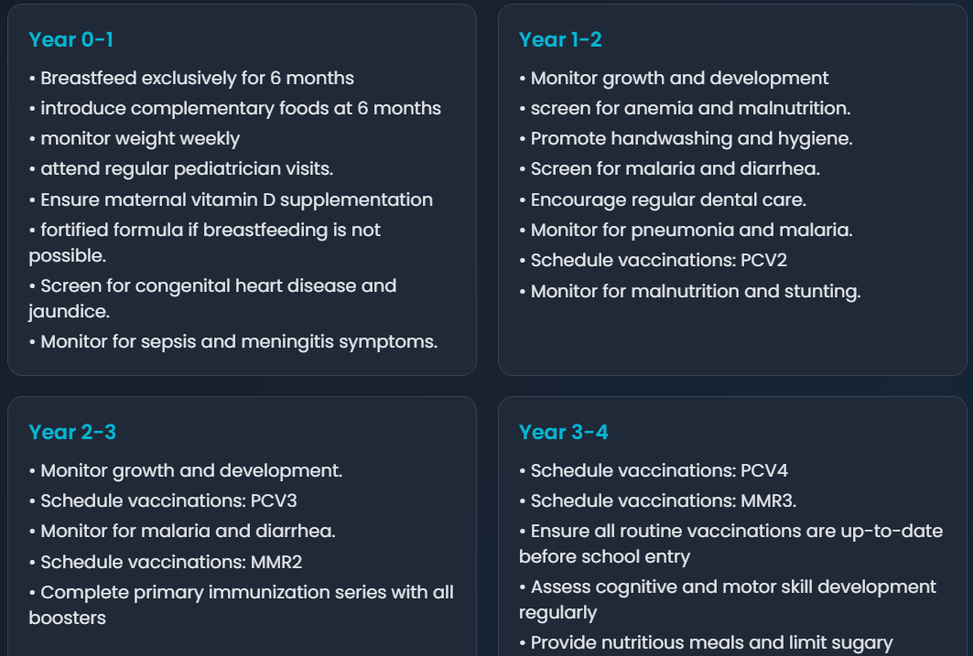
Modules
AI Survival Plan Generator Module
  Generates a personalized, year-wise care plan (0-5 years) to reduce mortality risk using GPT-based AI guidance.
  Key Functionalities:
  HuggingFace GPT Integration – Generates 0-5 year actionable survival plans
  Prompt Engineering – Ensures output follows a fixed format
    Year 0-1 , Year 1-2, Year 2-3, Year 3-4, Year 4-5
  Personalized Recommendations – Tailored steps based on nutrition, immunization, birth weight, maternal age, etc..

Slide 12
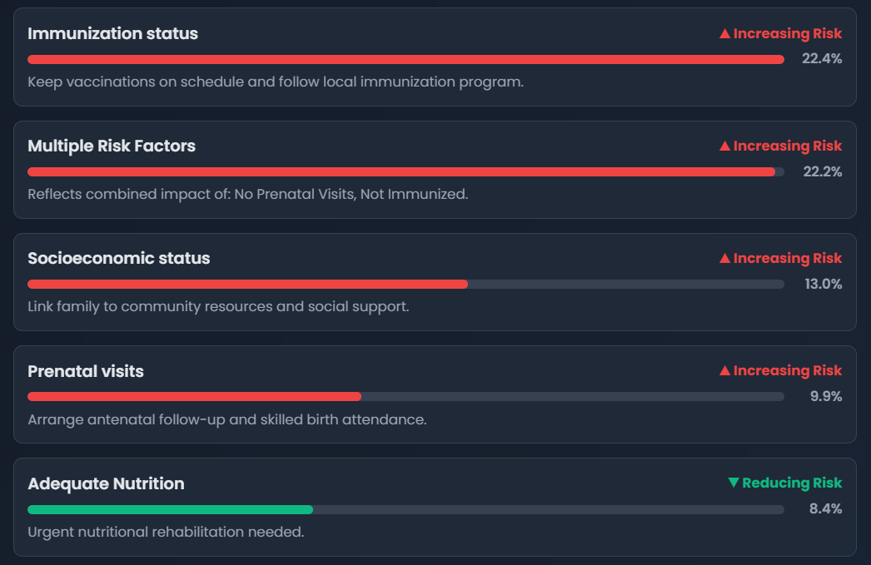
Modules
Explainable AI (XAI) Module
  Provides clear, human-understandable explanations for ML predictions.
  Key Functionalities:
  Multi-Stage Explainability Pipeline – Uses SHAP (primary), linear coefficients, and heuristic fallback to generate explanations
  Feature Impact Indicators (↑ increases risk, ↓ decreases risk, → neutral)
  UI Integration – Expandable “Explain Prediction” section in UI

Slide 13
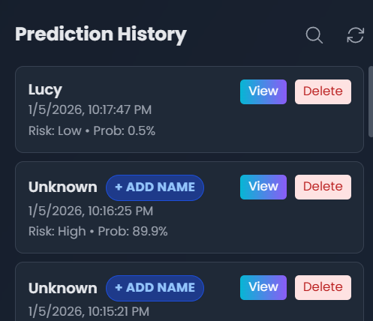
Modules
Data Handling & Persistent Storage Module
  Enable long-term storage and retrieval of user prediction history
  Key Functionalities:
  SQLite Database –Replace in-memory storage with persistent DB
  User History Retrieval – Logged-in users can view past predictions
  Guest-to-User Migration – Local history merges into DB after login
  Delete History –Remove specific prediction entries

Slide 14
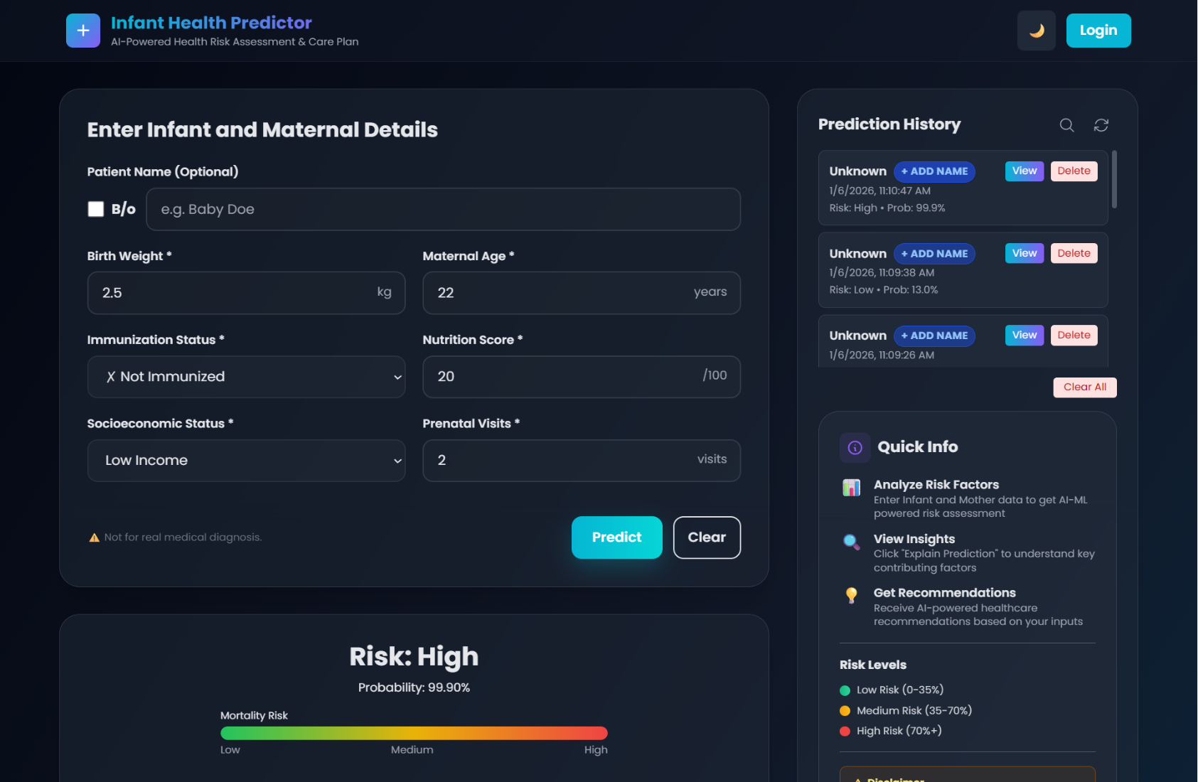
Result Evaluation

Slide 15
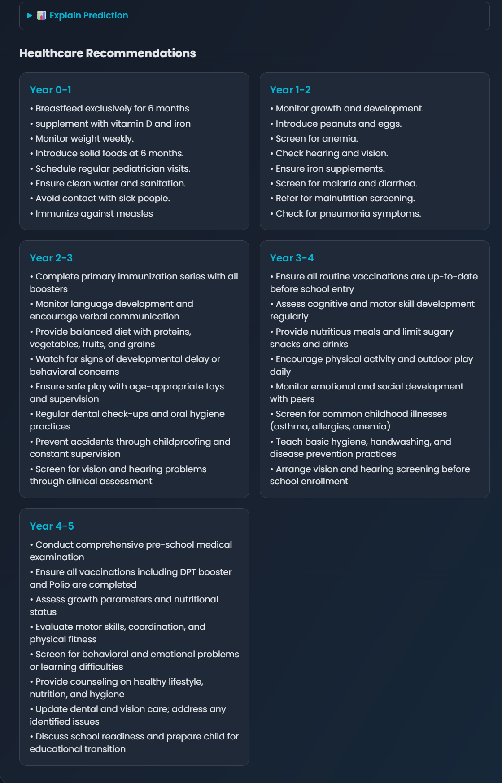
Result Evaluation

Slide 16
Conclusion
The system successfully integrates Machine Learning (CatBoost) and GPT-based AI to predict infant mortality risk and provide personalized survival plans.
A working Flask Backend API and Web UI enable real-time prediction and guidance delivery.
Early evaluations show strong model accuracy (0.9612) and meaningful, structured AI recommendations.
The combined ML–AI approach demonstrates significant potential to support proactive pediatric care and improve early intervention outcomes.
Planned enhancements include persistent storage, SHAP explainability, and expanded clinical validation to further strengthen system reliability and impact.

Slide 17
REFERENCES
Singh, M., Rao, K. Intelligent Health Monitoring System for Infants Using Machine Learning, 2023.
Zhang, Y., Wang, L., Chen, H. Deep Learning Models for Neonatal Mortality Risk Assessment, 2021.
Johnson, A., Smith, M., Brown, R. AI-Based Clinical Decision Support Systems, 2022.
Singh, K., Patel, R., Verma, S. Machine Learning Approaches for Infant Mortality Prediction, 2020.
Ribeiro, M. T., Singh, S., Guestrin, C. “Why Should I Trust You?” Explaining the Predictions of Any Classifier, 2016.
Badawi and M. J. Breslow, “Readmissions and death after icu discharge: development and validation of two predictive models,” PloS one, vol. 7, no. 11, p. e48758, 2012.
N. Al- Subaie, T. Reynolds, A. Myers, R. Sunderland, A. Rhodes, R. Grounds, and G. Hall, “C-reactive protein as a predictor of outcome after discharge from the intensive care: a prospective observational study,” British journal of anesthesia, vol. 105, no. 3, pp. 318– 325, 2010.

